Slide 1
EDA on TRAI SpeedTest
PROJECT FOR INSAID GCDAI BY PRAVIN BOLANGADY

Slide 2
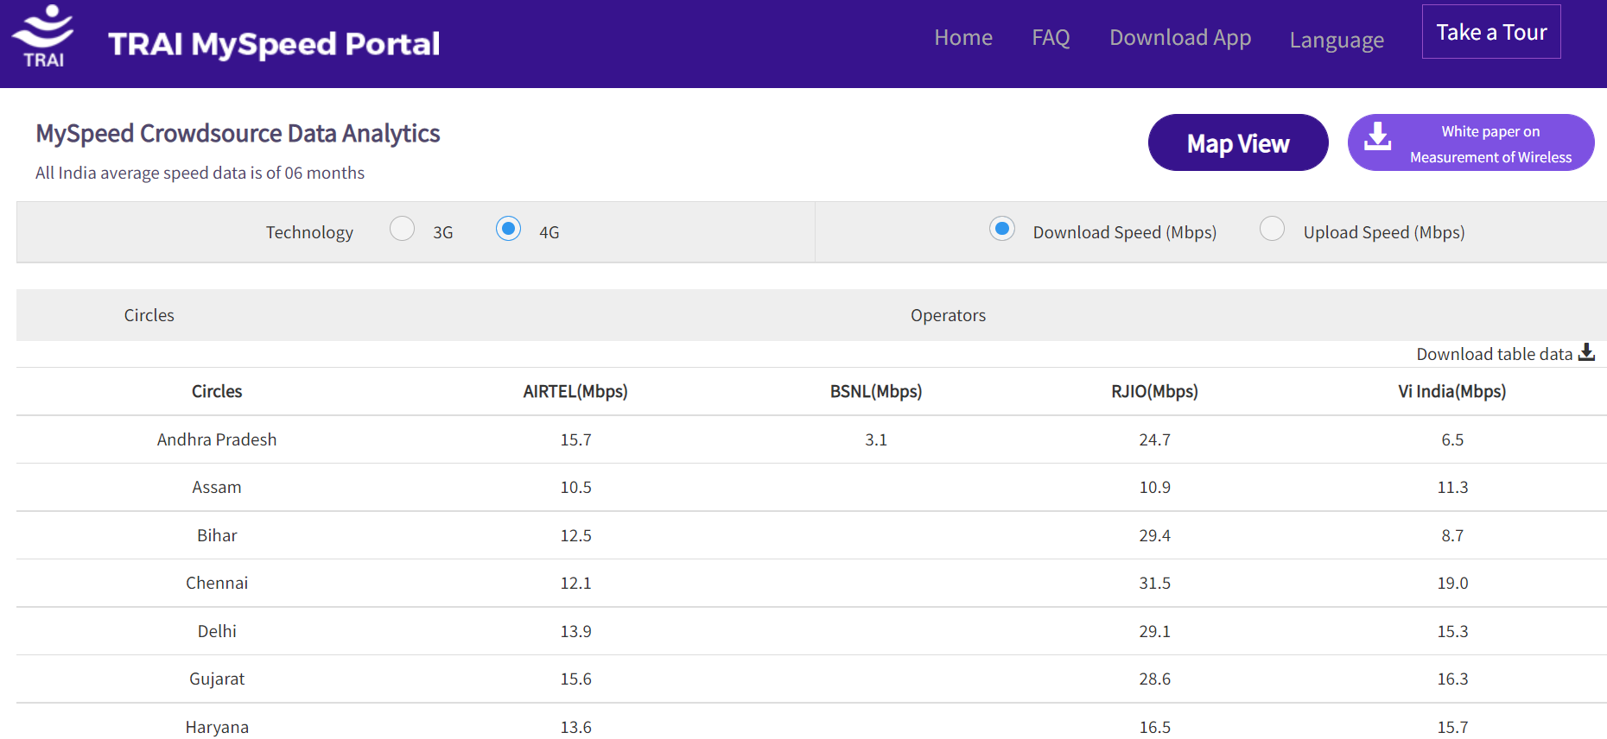
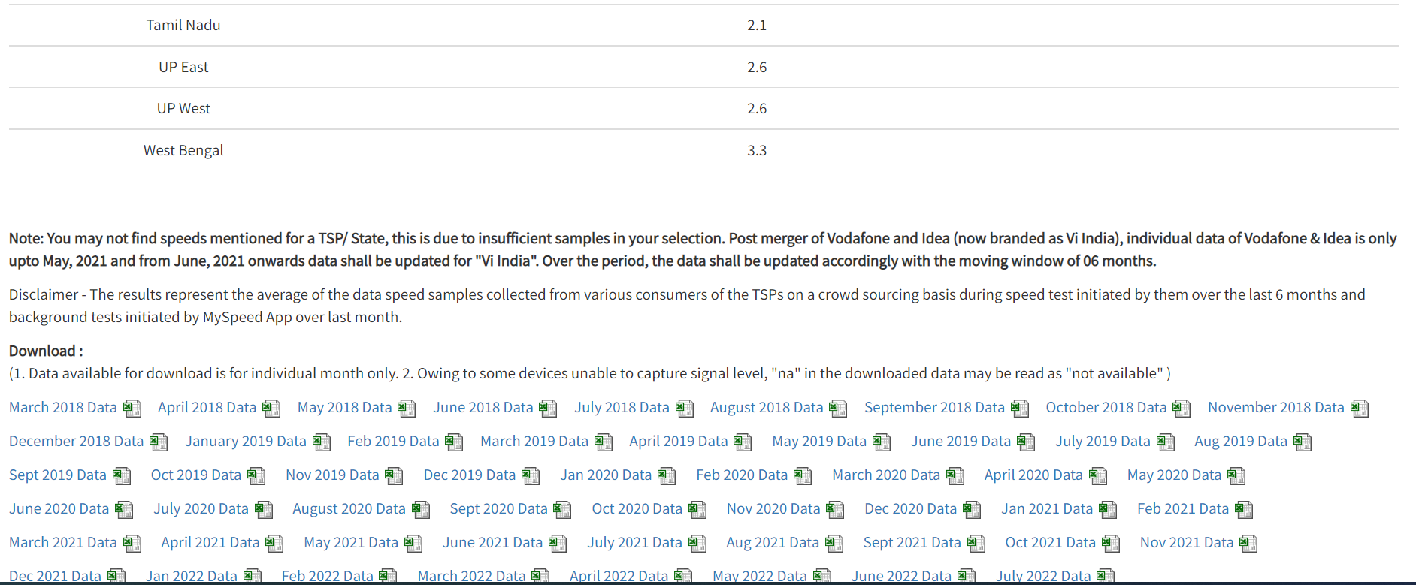
Introduction
TRAI has a Portal called "TRAI MySpeed Portal" which uploads the broadband speedtest performed by end users as well as TRAI's own diagnostics. Every month TRAI uploads a file with sampling of broadband performance across all the telecom circles spanning every Service Providers.

Slide 3
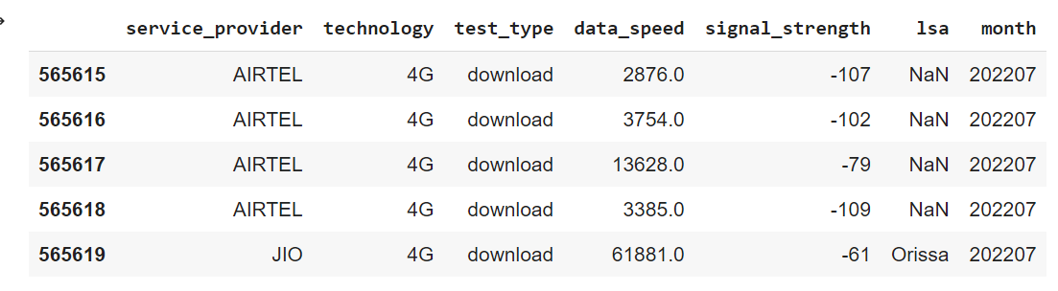
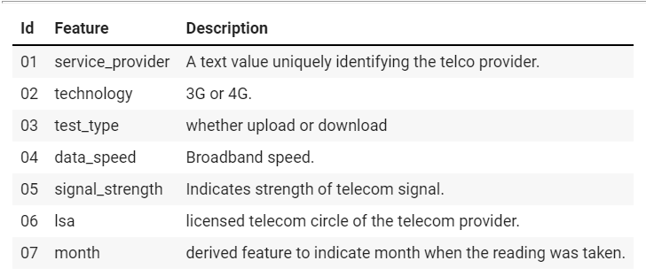
Introduction
Speedtest Sample File

Slide 4
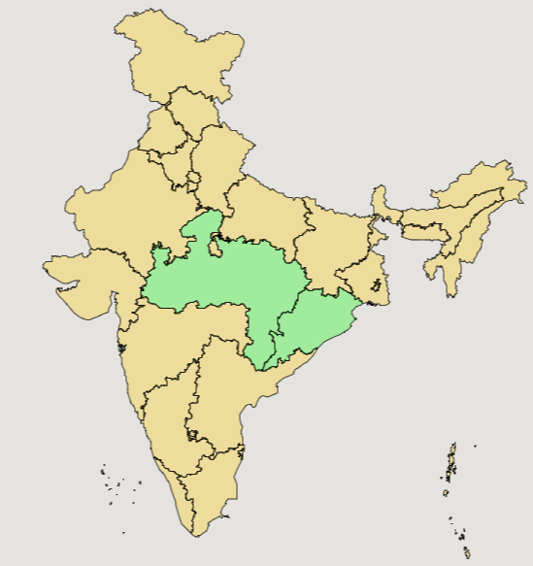
Introduction
Major Telecom Service Providers in India (3G, 4G)
Vi India,
JIO,
AIRTEL,
BSNL,
CELLONE.
Telecom Circles
UP East, Kerala, Maharashtra, Andhra Pradesh, Mumbai, Karnataka, Rajasthan, Haryana, Madhya Pradesh, Kolkata, Punjab, Tamil Nadu, Bihar, Chennai, Gujarat, Orissa, Assam, Delhi, UP West, Jammu & Kashmir, Himachal Pradesh, West Bengal, North East

Slide 5
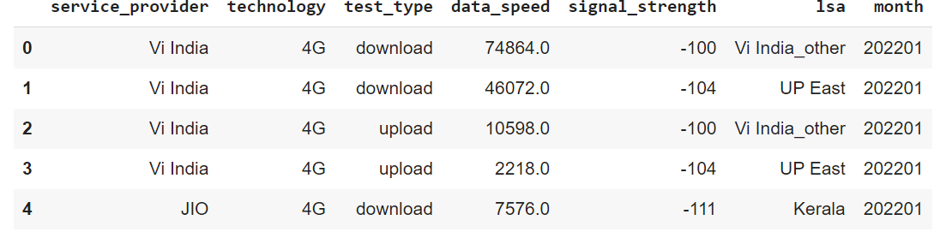
EDA - Data Pre-Processing
2747096 records with missing lsa column
Total records 4271439 : 7 columns; 7 months of data
service_provider+”_other”

Slide 6
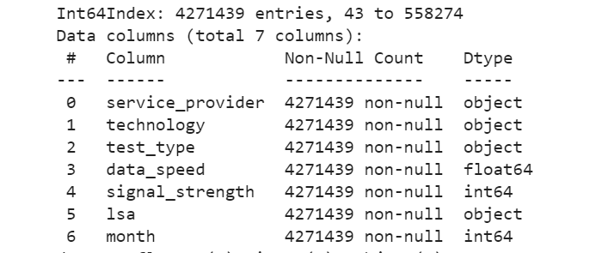
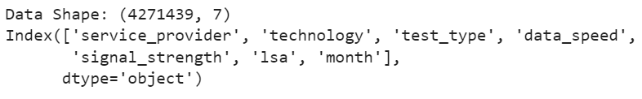
EDA - Data Post-Processing

Slide 7
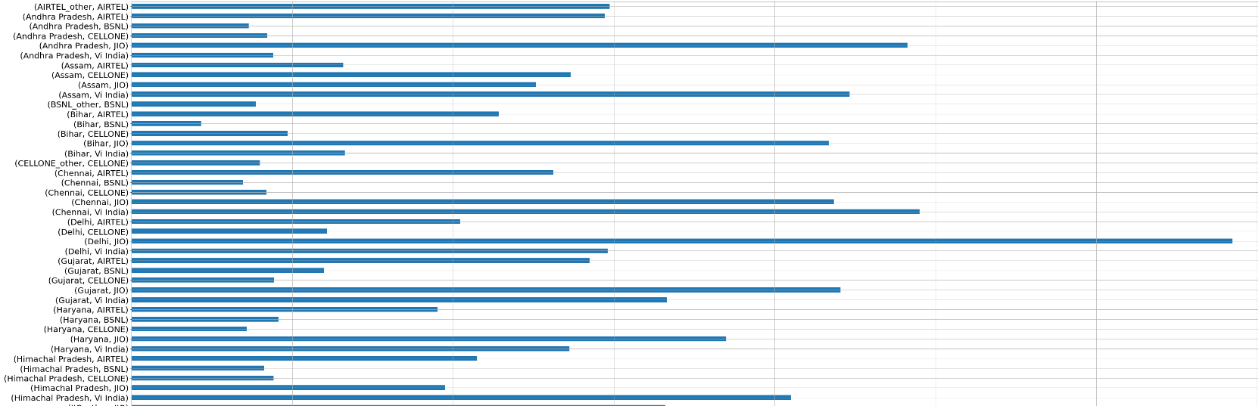
EDA – Analysis 1. Relation between data speed and lsa

Slide 8
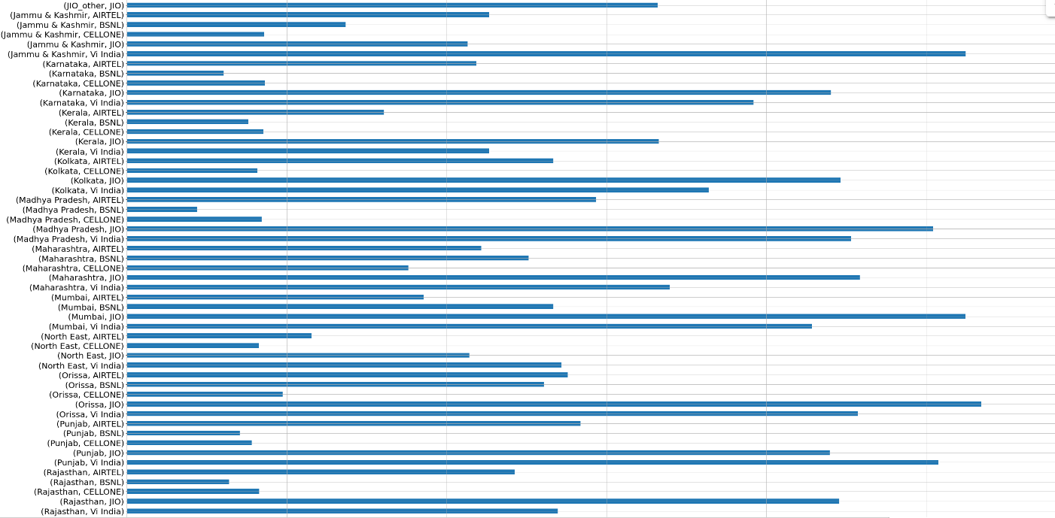
EDA – Analysis 1. Relation between data speed and lsa

Slide 9
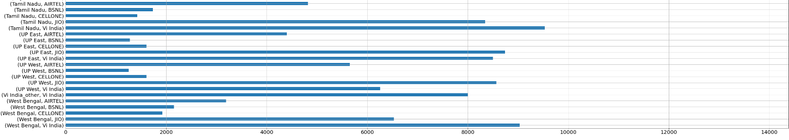
EDA – Analysis 1. Relation between data speed and lsa

Slide 10
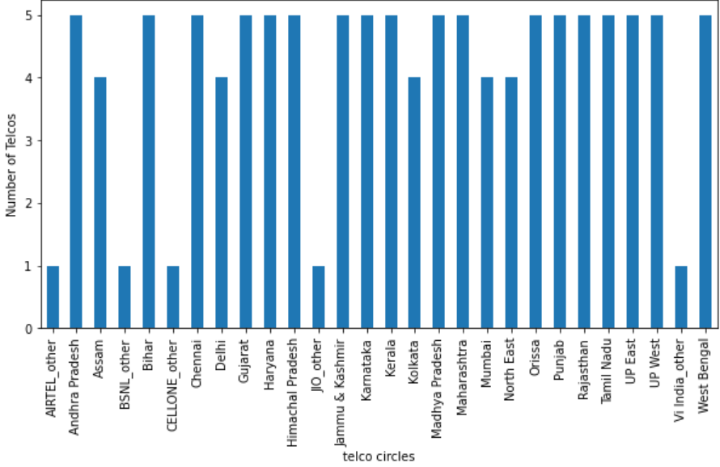
EDA – Analysis 2. How many Telcos present in each Telco circle?

Slide 11
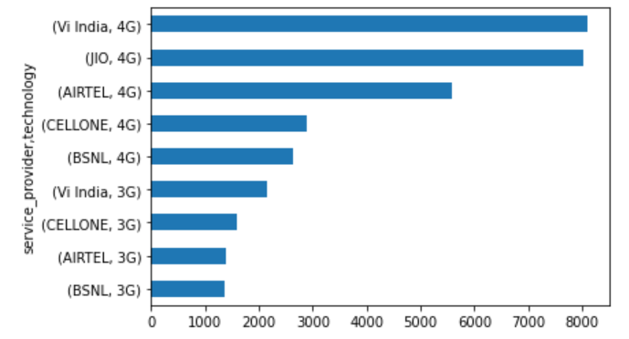
EDA – Analysis 3. What are the median data speeds supported by Telcos?

Slide 12
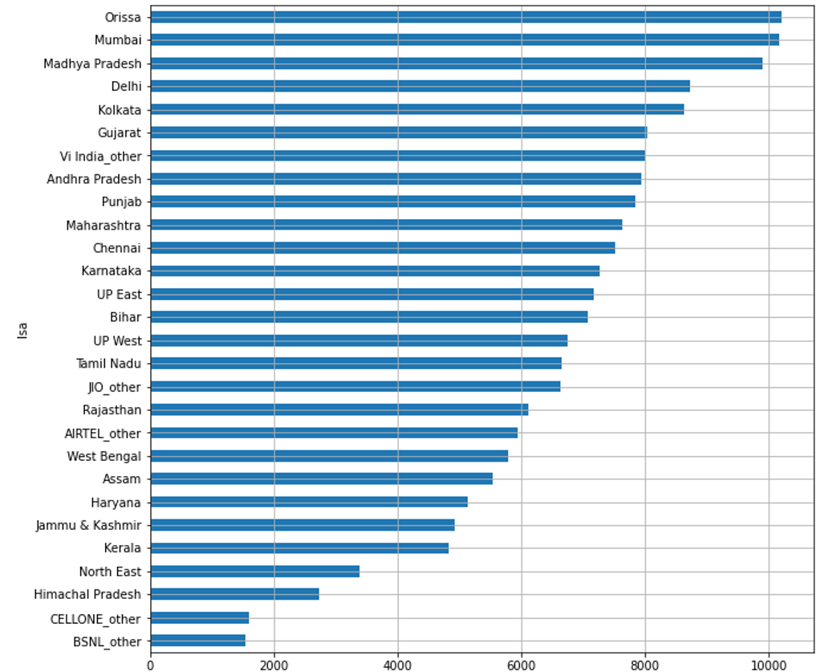
EDA – Analysis 4. Which Telco circles are best served in terms of broadband speeds?

Slide 13
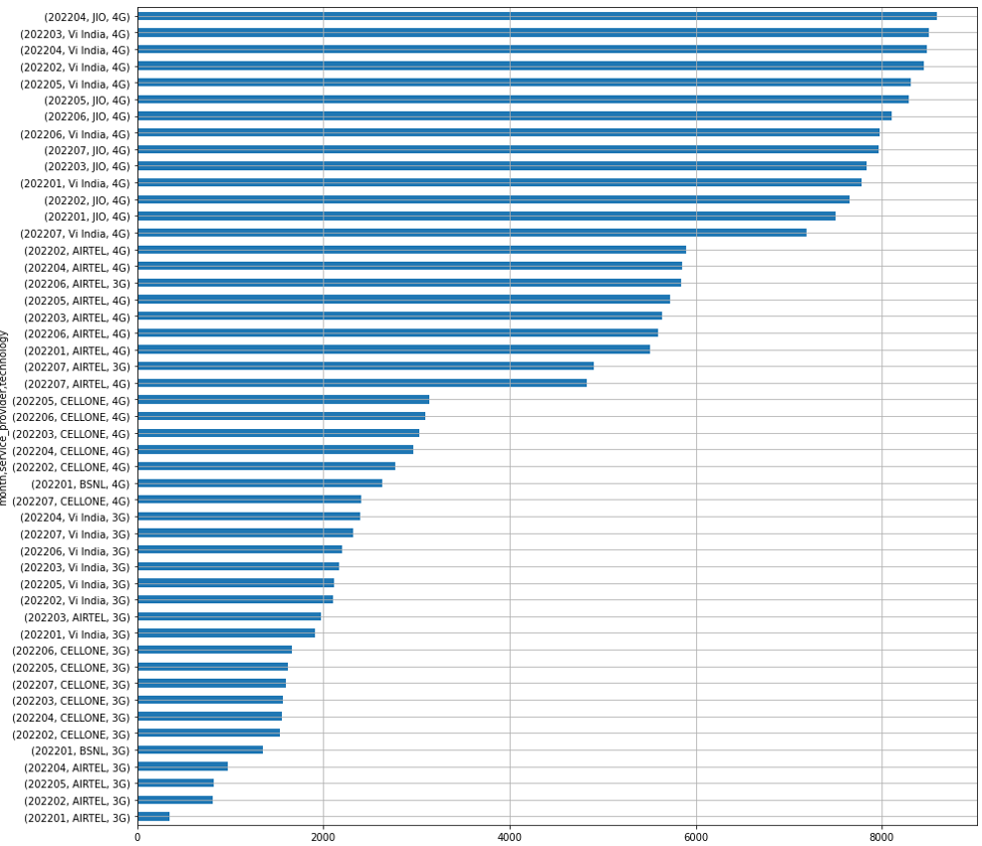
EDA – Analysis 5. Month-wise variations in the data speed for the telecom service providers?

Slide 14
EDA – Conclusion & Actionable Insights
Conclusion
In 4G technology, JIO and Vi India are the best Telecom Service providers giving highest broadband speeds.
The median broadband speeds for 4G providers shows increase from Jan to Mar and then decrease from April to July.
In 3G technology, VI India is the best service provider giving highest broadband speeds, followed by BSNL/CELLONE.
The median broadband speeds for 3G providers shows increase from Jan to Mar and then decrease from April to July.
Insights
Further analysis of individual telecom service provider is recommended to understand why there is a large variation in the data speeds across the LSAs served by the service provider.
The speedtest app needs to capture the LSA while taking the readings. Currently 50% of the speedtests do not have it.
The coverage of speedtest sampling should be expanded to cover LSAs within states like Telangana or Jharkand.

